Slide 1

Problem statement
Desing a trade brokerage system.
Functional Requirements:
Supporting request from multiple platforms such as Website, mobile, call.
Trades are booked in the system & sent to exchange.
Tasks supported : Trade Validation, Trade booking, trade update/cancelation, Reporting status.
No Functional Requirements:
Highly available
Volume : 100k/hour.
DB Space Requirements: 1 trade = 1 kb (assumption)
1 year = 12 months = 22(working days) *12= 264 * 7 (trading hours)= 1848*100000(volume)= 184.8 GB/per year. (approx.)

Slide 2

Architecture Selection:
Based on the stated requirements the solution can be created using a monolithic architecture as well as microservices architecture.
Monolithic architecture will possess challenges in terms of scaling, flexibility, fault isolation.
Microservices architecture will possess challenges in terms of costs due to additional infra(software & hardware) components required & complexity involved due to higher number of components involved.
Unless cost is a constraint & primary factor, due to the advantages in terms of scaling, flexibility & fault isolation. I would select the Microservices architecture for the system.

Slide 3
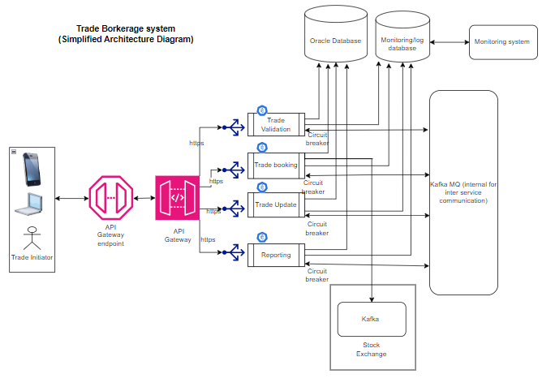

Slide 4
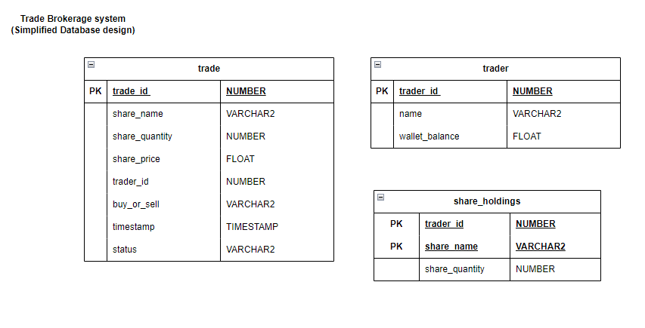

Slide 5
Microservices:
Based on the use cases I will propose below microservices :
Trade Validation Microservice :
Basic trade validations are performed by this service.
For a buy order, it will verify the wallet balance.
For a sell order, it will verify the holding quantity.
Trade booking Microservice:
Responsible for communicating with exchange & placing the order with exchange using their messaging system.
If trade is new, it will block the amount in wallet or quantity of shares and generate a unique trade id & save it in database.
Trade update/cancel Microservice:
Based on the request, update or cancel the trade request identified using unique id.
Block or release the amount/share quantity.
Send updates to the exchange.
Reporting Microservice:
After trade booking or cancel or update, this service will return the status(accept, reject, completed) of the trade to the trade initiator.
Returns trade details based on the user request using unique trade id.

Slide 6
High availability & Load Balancing : NGINX (Software Load balancer)
As this is a brokerage system so the system load would be limited to a specific type of user base which would be much lesser than a social media platform. Considering the load capacity that the platform might need to support I would opt to use a software load balancer for load balancing which should be able to handle the load expected & be cost effective as compared to a hardware load balancer.
Inter Service Communication & Volume support for 100K/hour request:
For the purpose of inter service communication & to handle the processing volume of 100k/hour. I would use Kafka queuing system which is open source, most used & relatively better performing system as compared to RabbitMQ or IBM MQ. Also, I am relatively more familiar with Kafka as compared to other queueing systems. I would like to take advantage of the previous familiarity unless any compelling point comes that makes me re-think or re-evaluate my decision.
Database:
As brokerage system is a financial platform dealing with money in real time where consistency & correctness of data is of paramount importance. I am inclined to use RDBMS systems like MySQL, Oracle, PostgresSQL.
However, based on the familiarity and the prior experience I am inclined to select Oracle which Oracle 19c onwards also supports JSON data & auto sharding as well along with RDBMS capabilities and would be a perfect fit for the system.

Slide 7
Resiliency:
For the purpose of resiliency, I will be taking care to implement retry mechanism for the failed calls for 3 times and in case the request fails 3 times then I will provide message to try later rather than keep trying to make the call endless number of times leading to resource consumption.
Monitoring:
For the purpose of monitoring, I will propose setting up a dedicated logging database where various relevant metric like response time, successful response count, failure count etc. can be stored & then a monitoring system like ELK , Promethus will be used to monitor, alert & analyze the performance of system.

